Slide 1



OIL DEMAND FORECASTING USING DEEP LEARNING TECHNIQUES
PROJECT REVIEW - 1
MENTOR : Ms.O Abhila Anju AP / AI
TEAM DETAILS
SNEHAVARSHINI S 21ADR048
BHUVANESHWARI C 21ADR009
SOUNDHARYA M 21ADR050

Slide 2
PROBLEM STATEMENT
Develop a deep learning model to accurately forecast future oil demand.
The project aims to analyze historical data, identify relevant features, and implement advanced neural network architectures to achieve precise predictions.
The focus is on leveraging deep learning techniques to address the complex and dynamic nature of oil demand, ultimately contributing to improved decision-making in the energy sector.

Slide 3
LITERATURE SURVEY
S. NO | TITLE OF THE PAPER | JOUNAL | PROPOSED MODEL | PERFORMANCE METRICS
1 | Time series forecasting of oil production in Enhanced Oil Recovery system based on a novel CNN-GRU neural network | ScienceDirect – 2023 | LSTM RNN CNN - GRU | RMSEs LSTM – 0.291 GRU – 0.420 RNN – 0.592
2 | A novel hybrid model based on deep learning and error correction for crude oil futures prices forecast | ScienceDirect - 2023 | variational modal decomposition (VMD) GRU LSTM | RMSE – 0.75 R-Squared – 0.997
3 | Deep learning framework for predictive modeling of crude oil price for sustainable management in oil markets | ScienceDirect - 2022 | Tree-structured Parzen Estimator (TPE) LSTM | RMSE – 3.202 R- Squared – 0.945
4 | Forecasting the U.S. oil markets based on social media information during the COVID-19 pandemic | ScienceDirect - 2021 | BPNN MLR RNN LSTM | RMSE – 1.9194

Slide 4
LITERATURE SURVEY
S. NO | TITLE OF THE PAPER | JOUNAL | PROPOSED MODEL | PERFORMANCE METRICS
5 | Optimized ANFIS Model Using Aquila Optimizer for Oil Production Forecasting | MDPI 2021 | ANFIS –(Adaptive Neuro-Fuzzy Inference System) Aquila Optimizer (AO) | ANFIS – R2 - 0.8980 AO- R2 – 0.9521
6 | Analysis and forecasting of crude oil price based on the variable selection-LSTM integrated model | Springer 2021 | RW, ARMA, LSTM, GRNN | ARMA – RMSE – 4.01 LSTM – RMSE – 2.21
7 | Forecasting oil production using ensemble empirical model decomposition based Long Short-Term Memory neural network | ScienceDirect 2020 | Ensemble empirical mode decomposition (EEMD) based Long Short-Term Memory (LSTM) | RMSE – 0.992 R2 – 0.957
8 | Forecasting Crude Oil Prices : a Deep Learning based Model | ScienceDirect 2017 | ARMA , LSTM | ARMA – MSE – 5.3811 LSTM – MSE – 5.5219

Slide 5
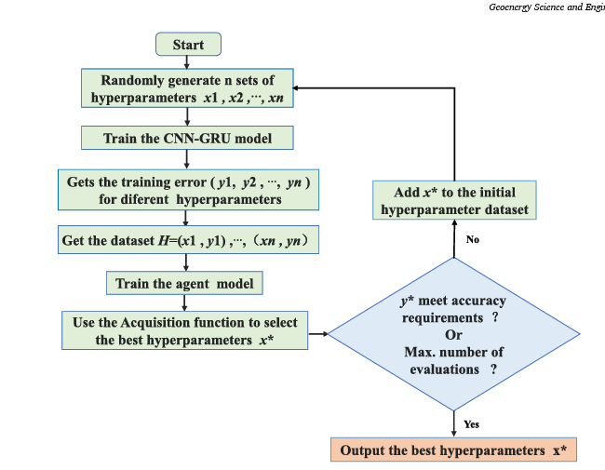
EXISTING SYSTEM (BASE PAPER)

Slide 6
PROPOSED METHODOLOGY - MODULES
1.Oil Production Forecasting
Reserves Analysis:
Evaluate available reserves data for oil fields.
Production Costs Examination:
Analyze production cost data associated with oil extraction.
Data Cleaning (Production-specific):
Address missing values and outliers in reserves and production cost datasets.
2.Oil Consumption Forecasting
Demographic Analysis:
Examine demographic data influencing oil consumption patterns.
Economic Indicator Review:
Analyze economic factors affecting oil consumption.
Data Cleaning (Consumption-specific):
Address missing values and outliers in demographic and economic indicator datasets.

Slide 7
Proposed Methodology – Algorithm
1.Quantitative Analysis:
Statistical Methods (ARIMA, SVR): Capture trends, seasonality, and non-linear relationships in production data.
Soft Computing Methods (LSTM, CNN): Handle complex temporal and spatial patterns, such as geographical distribution of reserves.
Numerical Simulation (ABM): Simulate the behavior of oil companies considering production capacity, costs, and investment strategies.
2.Qualitative Analysis:
Assessing the limitations, assumptions, and interpretability of each quantitative model.
Incorporating expert knowledge and industry trends to provide context and interpretation to the quantitative results.
WTI stands for West Texas Intermediate, which is a specific grade of crude oil and one of the main global oil benchmarks.

Slide 8
Datasets Chosen
Dataset 1: IEA Energy Prices
Focus: Monthly end-user prices for transport fuels in selected countries.
Source: IEA Energy Prices database.
Frequency: Updated monthly.
Scope: Covers gasoline, diesel, and potentially other transport fuels.
Limitations: Limited to specific countries and does not directly provide production or consumption data.
Dataset 2: Maritime Transport Costs (MTC)
Focus: Bilateral maritime transport costs for various commodities.
Source: Trade and Agriculture Directorate (TAD) and various shipping sources from Organisation for Economic Co-operation and Development (OECD).
Frequency: Covers data from 1991 to the most recent available year.
Scope: Includes transport costs for oil and other products across 43 importing countries from 218 origin countries.
Limitations: Requires careful interpretation and use in conjunction with accompanying documentation due to specific methodologies and caveats.

Slide 9
EVALUATION METRICS
Mean Absolute Error (MAE): Average of absolute differences between predicted and actual values. Formula: Σ |(y - y_pred)| / n
Mean Squared Error (MSE): Average of squared differences between predicted and actual values. Formula: Σ (y - y_pred)^2 / n
Root Mean Squared Error (RMSE): Square root of MSE, in the same unit as the data. Formula: √(Σ (y - y_pred)^2 / n)
Mean Absolute Percentage Error (MAPE): Average of the absolute percentage errors. Formula: (1/n) Σ |((y - y_pred) / y) * 100| %
Symmetric Mean Absolute Percentage Error (SMAPE): More robust alternative to MAPE. Formula: (1/n) Σ |((y - y_pred) / (|y| + |y_pred|)) * 2 * 100| %
R-Squared (R^2): Proportion of variance in actual values explained by the model. Formula: 1 - Σ (y - y_pred)^2 / Σ (y - y_avg)^2

Slide 10
REFERENCES
https://www.sciencedirect.com/science/article/abs/pii/S2949891023011156
https://www.sciencedirect.com/science/article/pii/S0301420723003136
https://www.sciencedirect.com/science/article/pii/S0957417422016992
https://www.sciencedirect.com/science/article/pii/S0360544221006526
https://www.mdpi.com/2227-9717/9/7/1194
https://energyinformatics.springeropen.com/articles/10.1186/s42162-021-00166-4
https://www.sciencedirect.com/science/article/pii/S092041052030108X
https://www.sciencedirect.com/science/article/pii/S1877050917326169

Slide 11
THANK YOU

